Slide 1
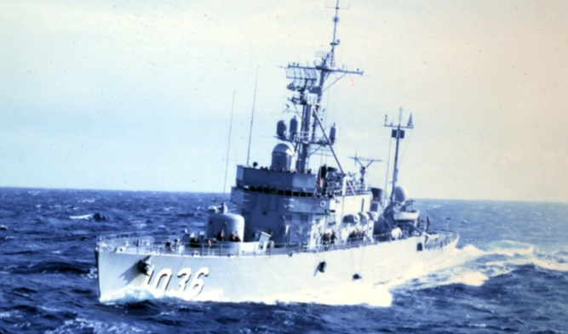
1033-Class Destroyer Escorts and
Pony Express
The Forgotten Platform
Notes:
Powerpoint presentation for 2019 Symposium on Cryptologic History.
Presented by Mark J. BORGERSON
Cleared for public presentation by NSA Pre-Publication Review Case PP-19-0974 on 8/22/2019

Slide 2
Background
The SALT-I treaty, signed in 1972, limited the number of ICBMs and SLBMs each party could deploy and strictly limited ABM systems.
SALT-II negotiations started in 1972 and limited the number and type of strategic warheads.
Collection of telemetry from opposition missile tests allowed the US and Soviet Union to verify compliance with the SALT treaties
Notes:
SALT specified that telemetry was to remain unencrypted
There was no requirement to specify the format and sensors

Slide 3
SALT did not limit missile range
Initial tests of the SSN-8 shocked the US defense establishment
The area from which a Soviet sub could attack the US expanded enormously
This became a major problem for the US Navy
Telemetry collection became a very high priority mission
Notes:
SSN-8 had about three times the range of its predecessor, the SSN-6.
This slide shows the enormously greater area from which Soviet submarines could launch SLBMs targeted on San Francisco.
The problem was just as bad on the east coast of the US.
Soviet submarines would no longer have to transit the GI-UK gap.
Determining the accuracy, payload weight and reliability of these new missiles was a very high priority.

Slide 4
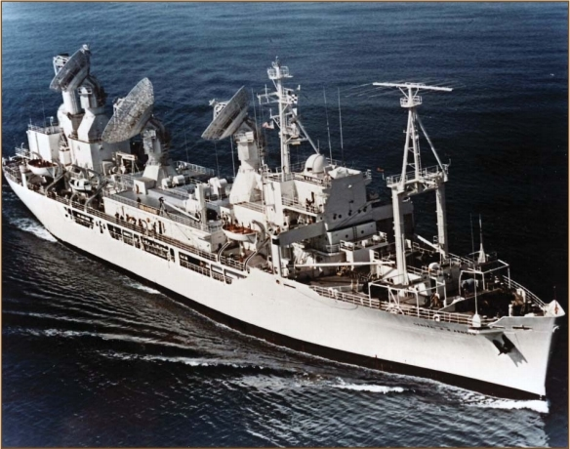
Telemetry Collection Assets
Anders: Shemya Island
StoneHouse: Ethiopia
Transportable Systems
EA-3B Aircraft
USNS H.H. Arnold TAGM-9
USNS Hoyt Vandenberg TAGM-10
From NSA CCH Publication: Telemetry Intelligence (TELINT) During the Cold War
Notes:
These are the platforms covered in the NSA publication
Stonehouse was discussed by several speakers in session 2C yesterday
The Vandenberg and Arnold were converted cargo ships originally built near the end of WWII.
The tracking radars and a high-gain telemetry dish made these ships ideal for telemetry intercept.
Their maximum speed of about 16 knots meant that they might need early warning to arrive in the BOA

Slide 5
The Hidden Assets:
USS Claud Jones DE-1033
USS John R. Perry DE-1034
USS Charles Berry DE-1035
USS McMorris DE-1036
Notes:
Missing from the NSA publication are four destroyer
Two of the four were generally in port at PH ready for short-notice PE Ops
This photo of the McMorris shows her approaching the Claud Jones in moderate seas in the BOANW of Midway Atoll

Slide 6
Claud Jones Class Destroyer Escorts
Specifications
Displacement:
1,314 long tons (1,335 t) standard
1,970 long tons (2,000 t) full load
Length: 312 ft 0 in (95.1 m) oa
Beam: 38 ft 0 in (11.6 m)
Draft: 12 ft 1 in (3.7 m)
Propulsion:
4 × Fairbanks-Morse 38ND8 diesel engines
9,200 shp (6,860 kW)
Single shaft
Speed: 22 knots (41 km/h)
Range: 7,000 nm (13,000 km) at 12 kn (22 km/h)
Complement: 175 (including CTs??)
Armament:
2 × single 3"/50 caliber guns (Aft guns removed on
Berry and Perry)
2 × triple 12.75 in (324 mm) Mk.32 torpedo tubes
2 × Hedgehog anti-submarine mortars
Notes:
The ships were built and launched in 1958 and 1959.
At the time I was aboard them, they were just 12 years old
This made them fairly new for naval ships which often have service lifetimes of 30 to 40 years
The class design was soon determined to be unsuited for escort duty
Too slow to keep up with carrier battle groups
New generation subs had submerged speeds faster than the DEs.

Slide 7
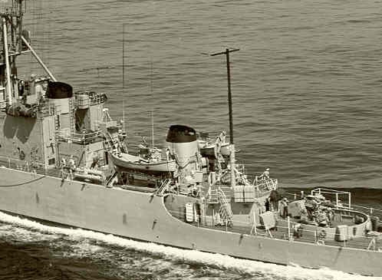
Telemetry Intercept Suite
Before Modification:
No SUPRAD compartment
No intercept antennas
After deck gun
Notes:
The DEs were modified for telemetry intercept in the late 1969 and 1970.
This photo shows the Berry before modification
SUPRAD is short for Supplementary Radio—The NSG working ares

Slide 8
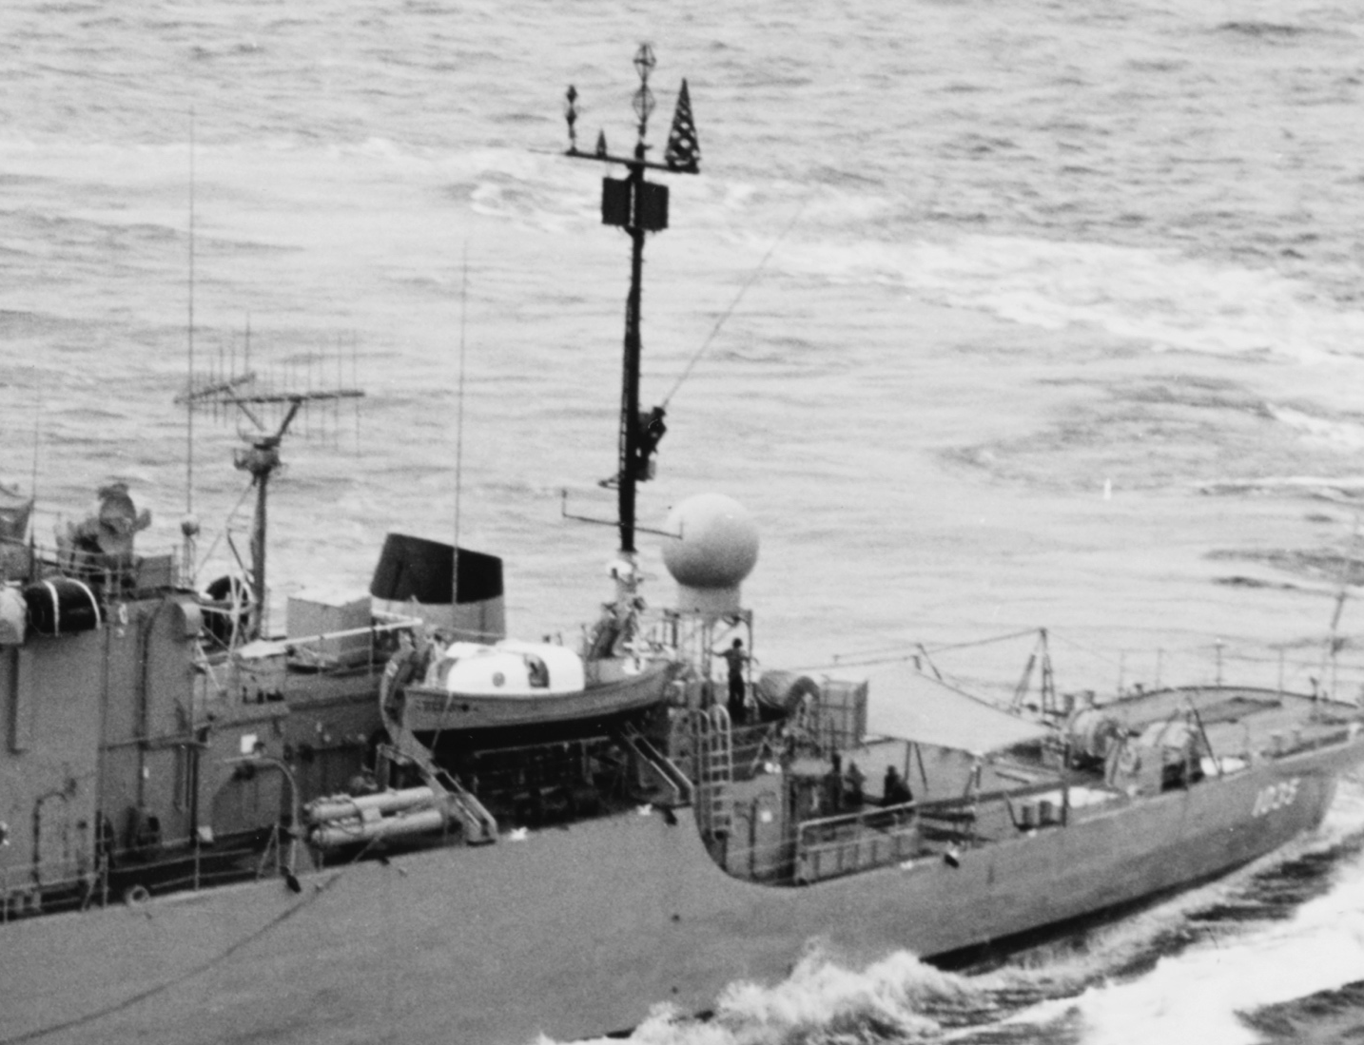
Telemetry Intercept Suite
After Modification
SUPRAD compartment in front of aft stack
Telemetry intercept antennas
SHF dish Antenna
Aft deck gun removed (Berry shown)
Notes:
The omnidirectional antennas above the preamplifier box were used for telemetry intercept.
The rotatable log-periodic VHF antenna in front of the after stack was used for telemetry intercept.
It also did a good job bringing in TV signals when operating near Oahu.
The dish antenna inside the dome aft of the after mast was used for SHF satellite communications.
It was generally not very useful as the aiming servos could not compensate for 20 to 30-degree rolls
The SATCOMM capability generally failed in a few days if seas were anything but dead calm
John R Perry got compartment, but not full PE electronics suite

Slide 9
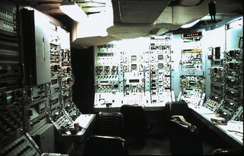
Telemetry Intercept Suite
SUPRAD Layout
Telemetry intercept positions
Supervisor position
14-track high-speed recorders
Test equipment
Chairs bolted to deck
HF intercept position (not visible)
NSG Secure comms (not visible)
Notes:
The photo shows the interior of the SUPRAD looking aft from the door to the radio room.
The teletypes and crypto gear for SECGRU communications were just to the right of the camera.
An HF intercept position was just to the left of the camera.
On the left are telemetry intercept positions and the two high-speed, 14-channel tape recorders
There was about a 15” space behind the equipment racks that provided maintenance access
That area was also used to for storage space for teletype paper, manuals, snacks and sodas.
Sodas were often placed in the overhead AC ducts for chilling.
At the far end are signal generators and test equipment.
To the right is another telemetry intercept position generally occupied by the supervisor (usually a CPO).
In the right corner you can see the display of a very precise digital time base display

Slide 10
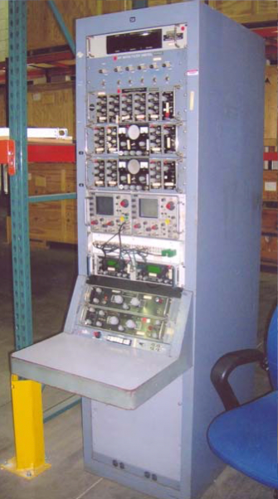
Telemetry Intercept Suite
Telemetry Intercept Position
Demodulators
Oscilloscopes for signal display
Patch Panel
VHF and UHF receivers
Bolted-down operator chair (not visible)
Notes:
This was my first encounter with radio receivers that had digital frequency displays.
I had hundreds of hours experience with R390A HF receivers that were mechanically tuned.
These TM receivers were electronically tuned using YIG filters
(resonating crystals whose resonant frequency could be changed with an applied magnetic field.
This equipment was near the State of the art electronics in 1970.
I was interested in electronics and I was like a kid in a candy store
(You can replicate most of the capabilities today, with better data recording,
using a good laptop, software, and a $150 USB SDR module)

Slide 11
Pros and Cons of using the DEs
Pros
  Four ships increased availability while allowing lower-priority tasks
  Faster transit to BOA (22Kts vs 12-15 for Vandenberg)
  Self Protection (remember the Liberty and Pueblo)
  Ships capable of underway replenishment
Cons
  Poor seakeeping qualities hard on equipment and personnel
  Limited SUPRAD and berthing space restricted NSG detachment size
  Required more frequent resupply than larger vessels
  Less capable telemetry intercept suite (particularly antennas)
  No capability for onboard telemetry analysis
  High Overhead—175 officers and sailors to support 15 CTs
Notes:
The seakeeping limitations had a significant effect on the NSG complement.
Rolls of +/- 30 degrees were common in rough seas
(and it seemed the seas were always rough!)
The addition of the SUPRAD and antennas made the DEs increased rolling.
The lack of the after 3” guns on the Berry and Perry may have improved their seakeeping.
In calm seas, they could simply shut down engines

Slide 12
Mission Profile
Administration and Training
CTTs, CTOs, CTMs assigned to Technical Guidance Unit, Pearl Harbor, a division of Naval Security Group Detachment, CINCPACFLT
Division officers assigned to either NSG Detachment or NSG Division, NAVCOMMSTA Honolulu (then TAD to CINCPACFLT as required)
Training facilities and administration at TGU building 395, Pearl Harbor Naval shipyard
Specialized training aboard one or two DEs pier-side at Pearl Harbor
Notes:
Administrative control of the PE program shifted from NCS Hono to CINCPACFLT in about 1972
Division officers were assigned other duties when PONY EXPRESS was between missions.
I served as a DIRSUP division officer on another program,
a division officer for a SPINTCOMM relay station,
an RPIO issuing officer (for a thankfully brief period)
and an assistant division officer at NAVCOMMSTA Honolulu.
The TGU building (395) was the admin center and training building for the PE riders.
While I was technically cleared for almost all programs, I only worked on PE and surface DIRSUP.
Officers served as JOOWs at COMNASECGRUPAC and had to be cleared for compartmented programs

Slide 13
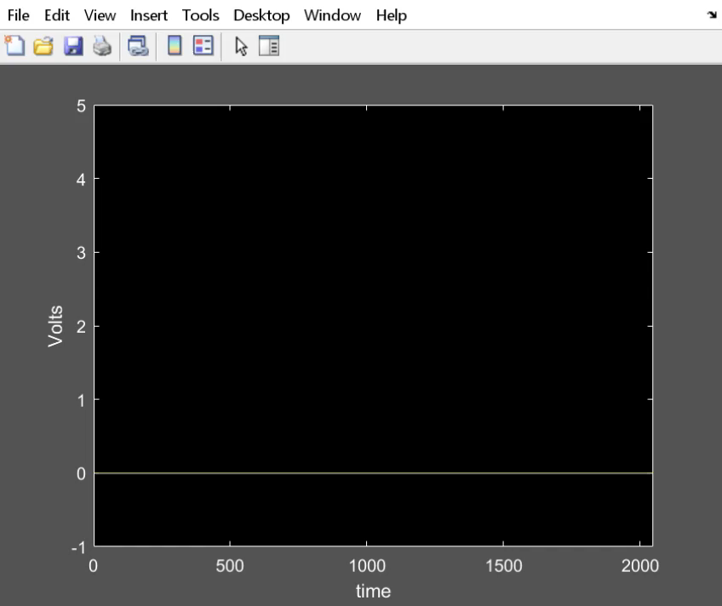
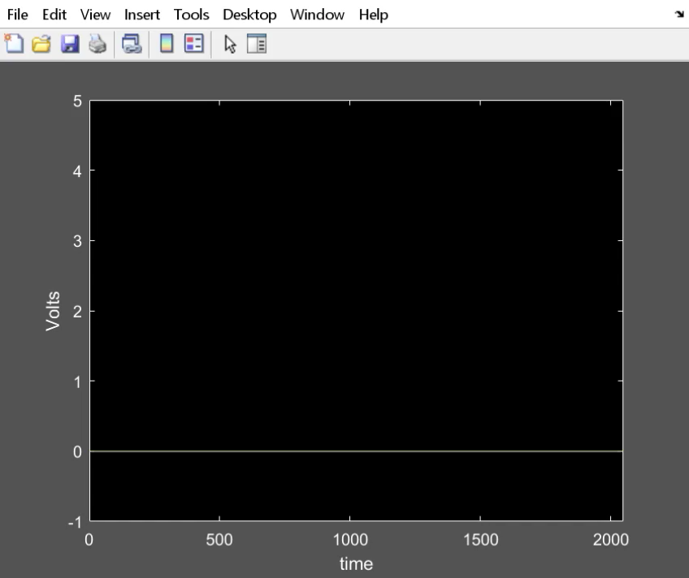
Mission Profile
Shipboard training
Basic equipment operation
Signal generators through patch panels
Training tapes of actual telemetry
Could not simulate actual intercept environment: too many signals, no ship’s motion
Notes:
One basic operator proficiency test was to tune and display a TV signal on the oscilloscope.
This required use of receiver, demodulators and oscilloscope.
When I was able to complete this exercise, I was awarded and honorary Tweaker (small tuning screwdriver)
I was told it was quite and honor—
The most dangerous thing on any warship was an ensign with a screwdriver
Operators learned to identify different types of telemetry signals
Tests with signal generators and tapes weren’t a good test of actual operating ability
No noise, known frequencies, strong signals
We developed a system that used multiple signal generators to simulate telemetry,
It was then broadcast at low levels through a spare antenna
Didn’t work well in port with many strong local signals
we didn’t want to use Soviet frequencies when we could be heard.

Slide 14
Mission Profile
Alert Phase
Commences with warning from DEFSMAC giving 24 to 48-hour notice of impending deployment
Teams selected and TAD orders issued for assignment to one of the DEs
CTs and division officer prepare for deployment for two to four weeks
Ships take on supplies and CTs and division officer move aboard ship
Typical PE Team
1 Division Officer
1 CTT CPO
6 CTT Telemetry collection operators
2 CTO Communications operators
3 CTR Collection specialists
2 CTM Maintenance technicians
Notes:
The typical alert started when I walked into TGU and someone announced “the SMRIS are out”
This meaning that the Soviet tracking ships had left port in Petropavlovsk
Teams Assigned:
The CTs generally came from TGU, but if an RT operator was assigned, he often came from another unit.
PE Riders usually had about 48 hours notice of an operation.
Most ship’s officers lived ashore in family housing or BOQ requiring hasty arrangements for deployment
Officer food supplies were paid for by the officers, purchased and prepared by the ship’s stewards

Slide 15
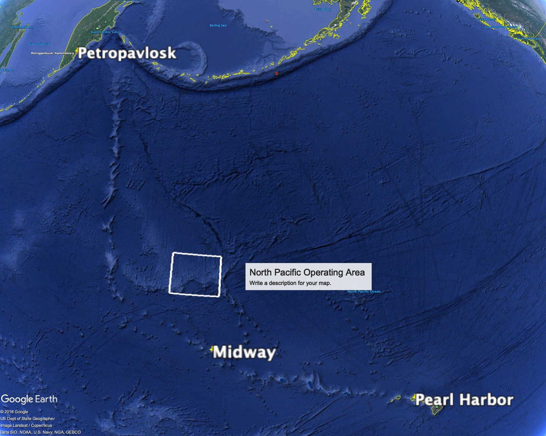
Mission Profile
Transit to Operations Area
DE departs Pearl Harbor and heads toward Midway Island
CTs and division officer settle in to shipboard life
Setup and testing of SUPRAD equipment
Establish and maintain NAVSECGRU communications channels
Notes:
The North Pacific BOA is about halfway between the SMRIS home port of Petropavlovsk and Pearl Harbor
It could take a few days to a week to get your sea legs---some people never did.
I was seldom seasick to the point of nausea, but I often felt tired
We all accumulated bruises from collisions with bulkheads and equipment.

Slide 16
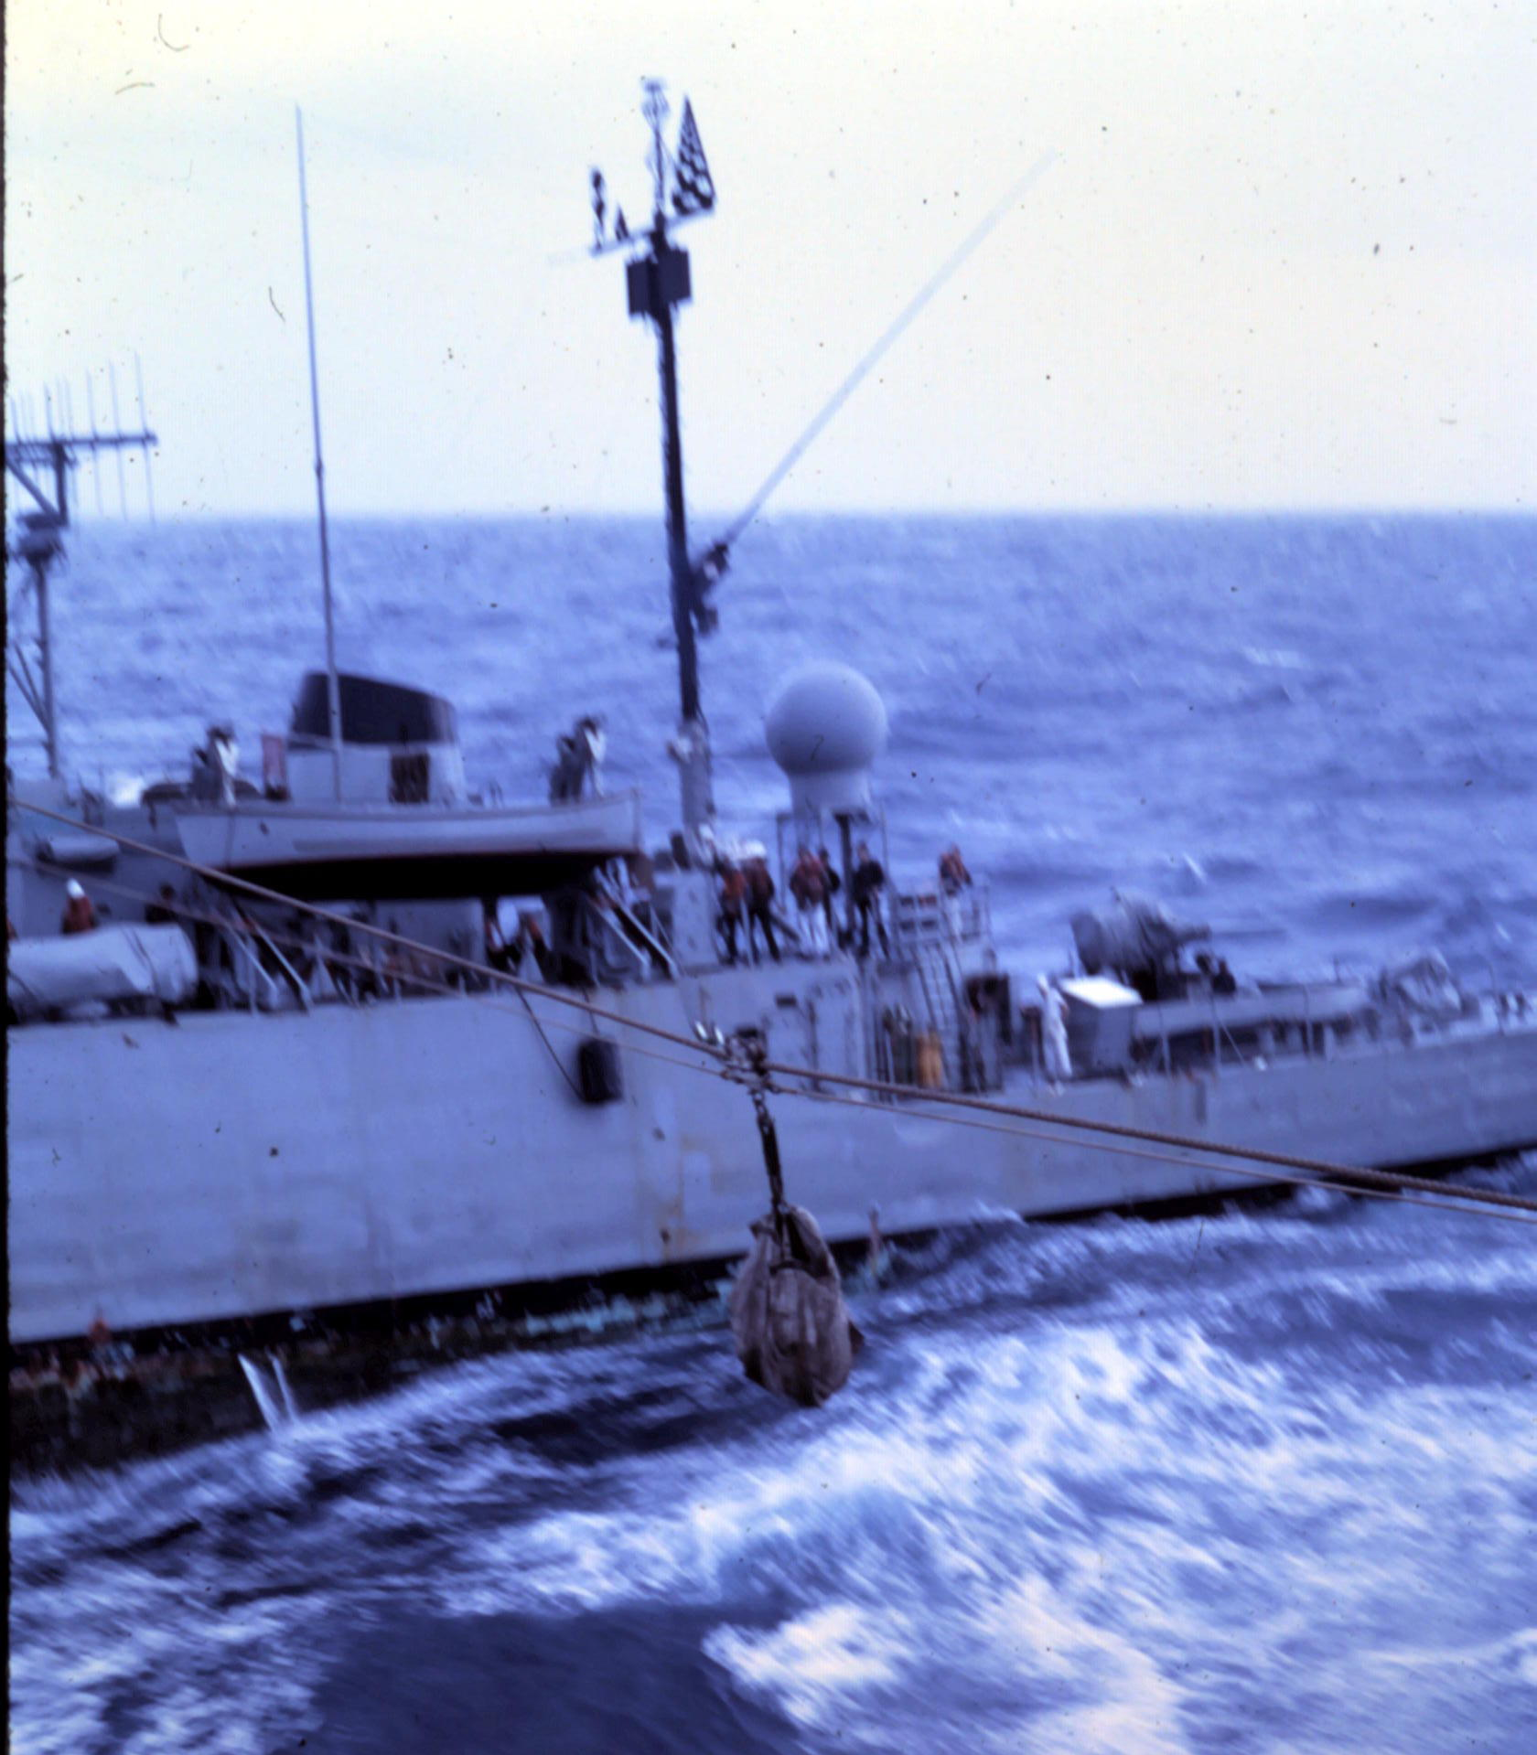
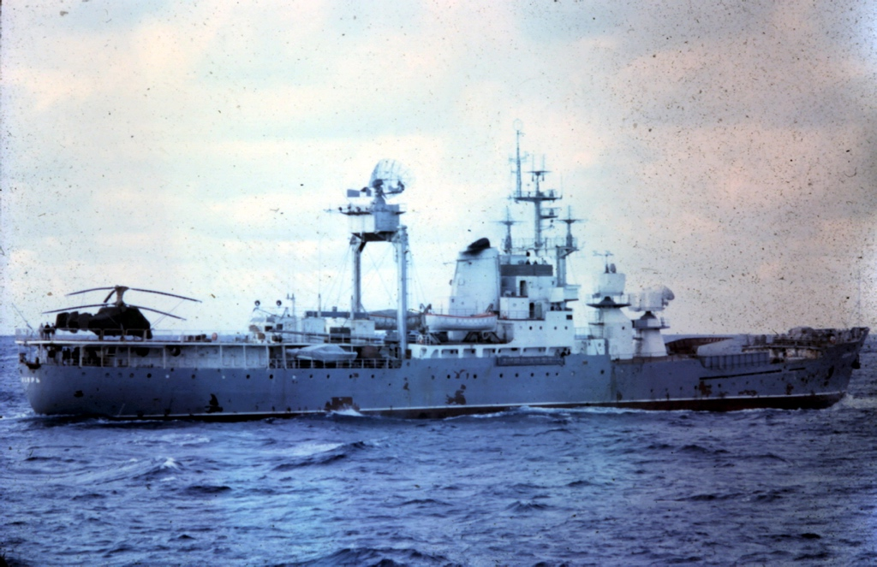
Mission Profile
On-Station Surveillance
Locate and observe Soviet Missile Range Instrumentation Ships
Maintain Secure Communications for launch alert
Resupply as required
Notes:
The SMRIS Chazma had a KH-47 helicopter
After a week or two at sea, we often received resupply from another DE that had left Pearl after us.
The most critical items were mail and key cards for the crypto gear.
(We left with minimal keying material and limited classified publications---memories of the Pueblo)
The DEs were sometimes refueled at sea, but most often made alternating runs to Midway for fuel and food.
Maintaining HF comms in the BOA was often difficult.
We referred to the BOA as the Black Hole of Midway— HF radio signals often disappeared

Slide 17
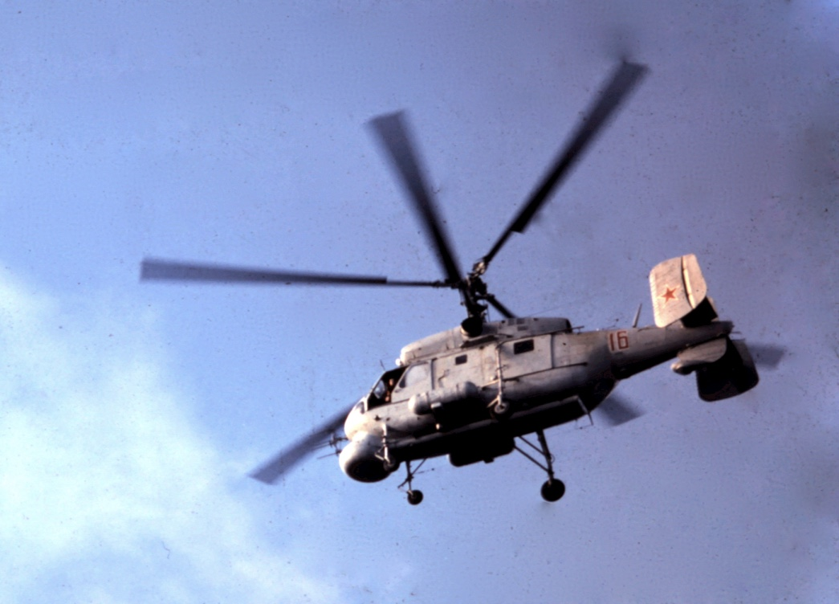
Mission Profile
Launch and Telemetry Intercept
  Early Collection
  Blackout
  Terminal Collection
  Impact and Warhead Destruction
Debris Collection
  Primary debris was Styrofoam chunks
Notes:
DE was often positioned near the center of the assumed impact area as defined by the positions of the SMRIS
Telemetry collection opportunity lasted just a few minutes with a brief blackout
as ionized gases generated by reentry heat blocked radio signals
Warhead destruction charge destroyed electronics and gave sound signal to precisely locate impact
Most frequent recovery was Styrofoam pieces—whose shape might indicate warhead size and contents
KH47 helicopter tried to collect debris before the DEs could get to it.

Slide 18
Mission Profile
End of Mission
  Mission ended when SMRIS left impact area or the DE was replaced by another ship
  Occasionally, copies of data were transferred to Vandenberg or Arnold
DEs Returned to Pearl Harbor
  Sometimes a refueling stop at Midway was necessary
CTs cleaned SUPRAD and slept a lot
Notes:
The Vandenberg and Arnold had analysis facilities and personnel
Sometimes the DEs got better telemetry in the impact phase due to closer proximity and omnidirectional antennas

Slide 19
My Last PE Deployment
1974 was a year which saw CLAUD JONES perform several missions which resulted in considerable time at sea. On 31 December 1973, CLAUD JONES received orders to proceed to the Midway Islands for Pony Express Operations involving surveillance of Soviet Units in the Broad Ocean Area. Within 24 hours of receipt of these orders the ship was enroute Midway ….
CLAUD JONES remained at sea for 71 consecutive days despite adverse weather and limited support making use of underway replenishments with the USS PIEDMONT (AD17), USS KIWISHI (AO-146) and USS SACRAMENTO (AOE-1), plus two brief refueling stops in Midway. The efforts of CLAUD JONES contributed significantly in making this Pony Express Operation a most successful operation…
I was released from active duty in March of 1974
Notes:
The first two paragraphs are from the 1974 command history of the Claud Jones
They were originally classified Secret. I received them via FOIA request.
Claud Jones was also at sea for about the last three weeks of December 1973
(which are part of the 71 consecutive days of sea time)
TGU and the ship probably knew about the orders a day before they were issued.
Berry and Perry were gone by then. Only the Claud Jones and McMorris remained
This is probably the reason for the very long deployment.

Slide 20
MUC Award
All 4 DEs (and several other units) received the Meritorious Unit Commendation for IVY GREEN operations in 1970
In a declassified 1973 CINCPAC command history IVY GREEN was described as follows:
“IVY GREEN operations were supplementary collection operations against foreign missile and space activities. Soviet tests monitored by the United States were conducted periodically during 1970 both in the mid-Pacific broad ocean area and in the Kamchatka Peninsula area. …”
Notes:
On 5 August CINCPACFLT informed CINCPAC that one of the destroyers observing a test series
had reported impacts at ranges of 3,500 yards east and 2,000 yards down range from him.
The ships were warned to take only the minimum
amount of classified material necessary for the mission.
The loss of the Pueblo was still fresh in the minds of the NSG.

Slide 21
The End Service for the DEs
Claud Jones DE-1033 Sold to Indonesia December 1974
John R Perry DE-1034 Sold to Indonesia February 1973
Charles Berry DE-1035 Sold to Indonesia January 1974
McMorris DE-1036 Sold to Indonesia December 1974
More cost-effective telemetry collection assets were available
Notes:
Claud Jones and McMorris deployed on PE ops from December 1973 to February 1974 and later in 1974 (after my time)
The DEs continued in service in Indonesia for about another 30 years.

Slide 22
Motivation, Declassification and Action
Motivation: I wanted to record this part of my life for my family and for the families of the men with whom I served on the DEs.
Action: I started collecting declassified documents and filing FOIA requests in 2015
Declassification: The NSA report on telemetry intercept during the cold war led me to believe much of the subject matter was no longer sensitive.
Notes:
My father was in the OSS and served behind Japanese lines in Burma.
He passed away about 18 years before the OSS personnel records and war report were released.
I had health issues in 2014 that motivated me to record my own experiences for my family.
I wrote a memoir of my 5 years in the Naval Security Group.
The SECGRU Years: Five Years in the Naval Security Group
Although I have had no access to classified information since 1974,
I felt obligated to comply with the secrecy agreement and submit my manuscript for pre-publication review.
It was returned with some redactions and cleared for public release about one year ago.
The pre-publication review process leaves a lot to be desired
particularly for persons like myself who are 45 years out from their own cryptologic history.

Slide 23
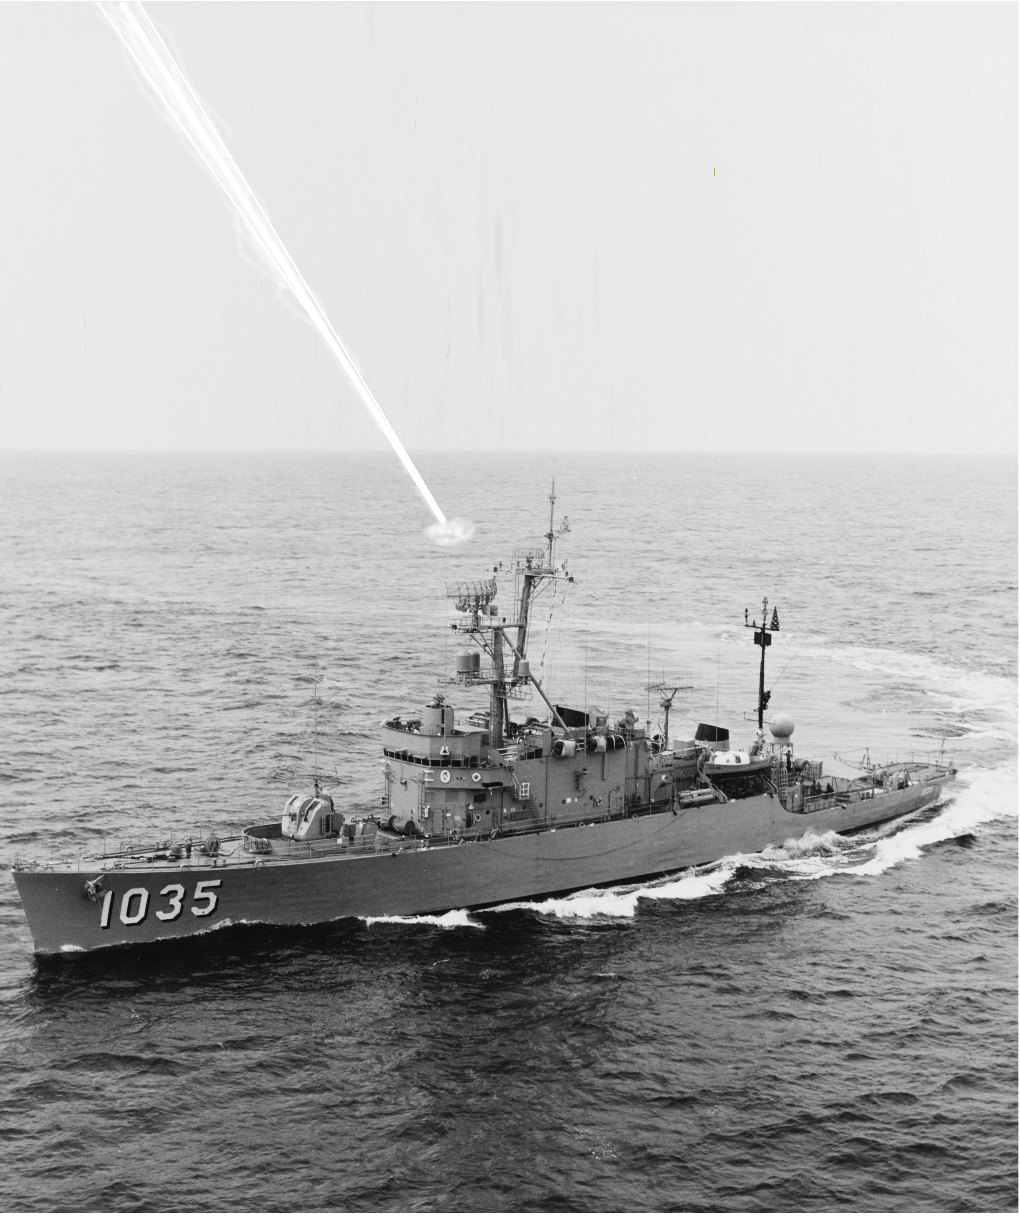
1033-Class Destroyer Escorts and
Pony Express
Notes:
Cover art based on US Navy photograph
My thanks go out to the destroyer sailors and CTs who made these missions possible.
HAZE GRAY AND UNDERWAY!

